Slide 1
Spreadsheet Evidence
By ...

Slide 2
P2 – Develop a complex spreadsheet model to meet particular needs

Slide 3
Multiple worksheets
P2
Print screen the different sheets that you have created and annotate where information is pulled from other sheets.
Notes:
Annotate your print screens!!

Slide 4
Complex Formulae
P2
Show examples of the different formulae you have used, including one that has at least a two step process.
Explain what these formulas do within your spreadsheet.
Notes:
Annotate your print screens!!

Slide 5
Large Data Set
P2
Print screen your sheet showing the sales data.
Notes:
Annotate your print screens!!

Slide 6
Data Entry Form
P2
This can be evidence of menu systems, list boxes, drop-down boxes or event controls.
Notes:
Annotate your print screens!!

Slide 7
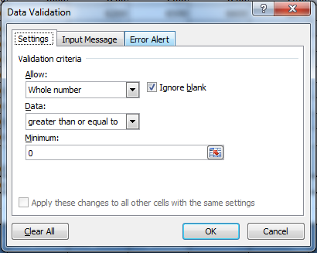
Data Validation
P2
On cells where you have to enter data, set up validation where you cannot enter a value less than 0.
Print screen evidence of this.
Notes:
Annotate your print screens!!

Slide 8
Nested IF Functions
P2
Print screen the IF statement that calculates the indicates the level of profit.
Annotate it and show examples of it working.
Notes:
Annotate your print screens!!

Slide 9
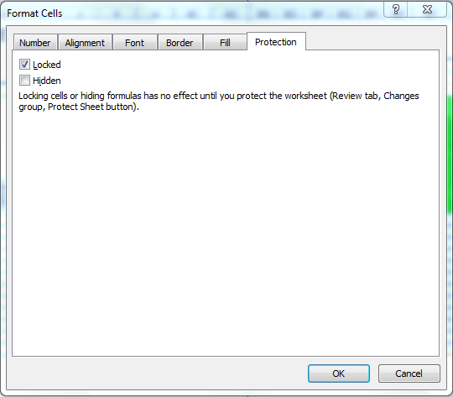
Cell Protection
P2
Protect cells that contain formulae or headings. Show evidence for this.
Notes:
Annotate your print screens!!

Slide 10
Cell Formatting
P2
Show evidence that you’ve formatted the cells to Number, Text and Currency.
Notes:
Annotate your print screens!!

Slide 11
P3 – Use formulae, features and functions to process information

Slide 12
Relative References
P3
Print screen formulas where you have relative cell references (no $ in the formula)
Explain what the formulas do.
Notes:
Annotate your print screens!!

Slide 13
Absolute References
P3
Print screen formulas where you have an absolute cell reference (with a $)
Explain what the formulas do.
Notes:
Annotate your print screens!!

Slide 14
Logical Functions
P3
Show evidence of IF and SUMIF functions and explain what they do within your spreadsheet.
Notes:
Annotate your print screens!!

Slide 15
Correct Operators
P3
Show formulae that includes +, -, * and /
Explain what the formulas do within your spreadsheet.
Notes:
Annotate your print screens!!

Slide 16
Named Ranges
P3
Print screen to show that you’ve name a range of cells.
Notes:
Annotate your print screens!!

Slide 17
Built-in Functions
P3
Show evidence of cell functions, lookup functions, text functions or statistical functions.
Notes:
Annotate your print screens!!

Slide 18
M1 – Refine a Complex Spreadsheet model by changing rules and values

Slide 19
Improving Efficiency
M1
Show evidence of shortcuts and aides for navigation.
Notes:
Annotate your print screens!!

Slide 20
Formatting
M1
Show evidence of fonts, page orientation, header and footer, print area, use of colour or conditional formatting.
Notes:
Annotate your print screens!!

Slide 21
P4 – Use Appropriate tools to present data

Slide 22
Charts
P4
Show evidence of each of the charts that you have created – annotate to show labels, titles, colours and that you’ve used and appropriate type of chart (line, bar, column, pie, xy – scatter).
Notes:
Annotate your print screens!!

Slide 23
Pivot Table
P4
Print screen the pivot table you have annotated.
Notes:
Annotate your print screens!!

Slide 24
Filtering Data
P4
Show some form of filtering within your spreadsheet.
Notes:
Annotate your print screens!!

Slide 25
P5 – customise the Spreadsheet Model to meet a given requirement

Slide 26
Checking Data
P5
Show evidence of data validation and range checking.
Notes:
Annotate your print screens!!

Slide 27
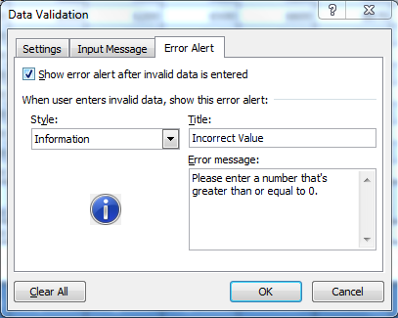
Error Messages
P5
Create an error message where you have used data validation. Print screen this and explain what happens.
Notes:
Annotate your print screens!!

Slide 28
Protecting Cells and Sheets
P5
Show print screen evidence of protecting cells and sheets.
Notes:
Annotate your print screens!!

Slide 29
P6 – Use Automated Features in the spreadsheet model to meet a given requirement.

Slide 30
Macros
P6
Print screen the macros you have set up.
Notes:
Annotate your print screens!!

Slide 31
Control Toolbox
P6
Show that you have used the Control Toolbox to produce buttons that are then linked to a macro.
Notes:
Annotate your print screens!!

Slide 32
Visual Basic
P6
Show the Visual Basic code for your macros.
Notes:
Annotate your print screens!!

Slide 33
M3 – Compare Different automation methods

Slide 34
Comparing Automation Methods
M3
Write a comparison of the different automation methods you have used (macros, Control Toolbox, Visual Basic)

