Slide 1
Spreadsheet Skills
For use with BTEC Unit 42 – Spreadsheet Modelling

Slide 2
Contents
Developer Tab
Dropdown Menu
OR Function
Password Protection
Recording Macros
Adding Buttons
Editing Buttons
Event Control
Customised Printing
Adding Navigation
Creating a Pivot Table
Creating an Alternative Format
Unlocking Cells
Protecting Sheets

Slide 3
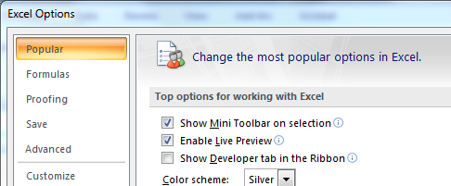
Developer Tab
In order to view the Control and Code toolbars, you will need to show the Developer tab.
Click on the Office button in the top-left corner of Excel and click on the Excel Options button at the bottom of the menu.
Tick the box Show Developer tab in the Ribbon and press OK.

Slide 4
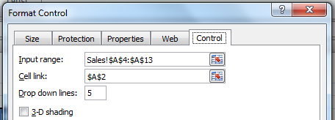
Dropdown Menu
Create a new sheet and call it Titles Data – this sheet will show data pulled from other areas of the spreadsheet.
Got to the Developer tab, then Insert and select Dropdown menu. Draw it out on your sheet.
Right-click on the menu, and select Format Control.
For the Input range, highlight a list showing all the titles on the Sales sheet. Set the Cell link to A2.

Slide 5
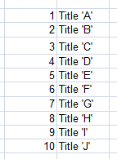
Drop down Menu
When you select a title from the list, it’ll show a number in the linked cell. We need to show more clearly what title has been selected for our lookups.
Create a table like this to the right of your sheet >
Highlight the table and all it titles
In the cell under the number, enter this formula:
=VLOOKUP(A2,titles,2)
It will look up the title name based on the number.
Set up a table like this below your drop down menu

Slide 6
Drop down Menu
SALES
Setup a series of VLOOKUPs that will find the data based on the chosen title.
For April 2010 sales, click in the empty cell. Type in =VLOOKUP(, select the cell that shows the title. Enter a comma and go to the Sales sheet and select the area showing the titles and the sales data (not the months). Enter another comma and type 2. Press enter. This will look up the sales data for April, which is in the second column of your selected table.
Continue adding VLOOKUPs for each month, making sure that you add the correct column number for the month you are looking up.

Slide 7
Drop down Menu
INCOME
Repeat the VLOOKUP process for income as you did for sales.
EXPENSES
Create a new table that shows the expenses for each title, per month. You will be adding together the expenses subtotal and the license fee.

Slide 8
Drop down Menu
EXPENSES
Create a new table that shows the expenses for each title, per month. You will be adding together the expenses subtotal and the license fee.
On your Title Data sheet, create a VLOOKUP to look for the expenses data of the selected title, much like your Sales and Income VLOOKUPs
PROFIT
This is a simple formula that will subtract expenses from your income.
Test your drop down menu and make sure all cells are formatted correctly.

Slide 9
Drop down Menu
This shows a sample from the table:
Add conditional formatting to the cells showing the profit.

Slide 10
OR Functions
You will need to add an OR function to your spreadsheet. We will do this on the Title Data sheet.
Enter this formula to the right of the last profit cell on your sheet. It will look for any profitable months and return one message, if there are no profitable months, it will give you another message:
=IF(OR(B8>0,C8>0,D8>0,E8>0,F8>0,G8>0,H8>0,I8>0,J8>0,K8>0,L8>0,M8>0),"Some Profitable Months","NO PROFITABLE MONTHS!")
Check your cell references when you enter this formula.

Slide 11
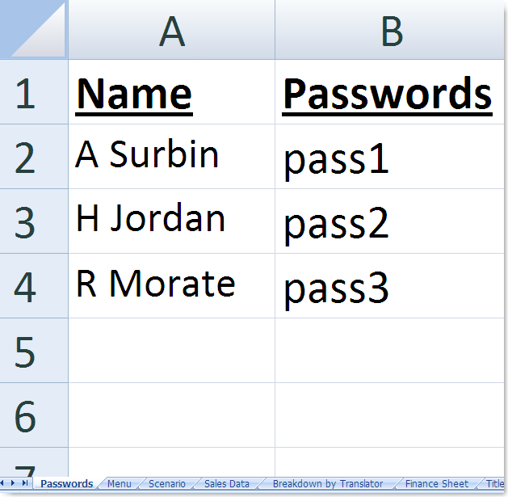
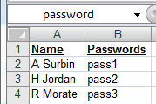
Create a simple password protection system
Create a sheet called Passwords with Names and Passwords listed in a table.
Make sure the list is
sorted alphabetically.
This is very important.
We will be using a lookup statement later, and these demand that lists are sorted!
Eventually this sheet will be hidden, and the range(B2:B4) can be formatted so the font colour is white. This will make the passwords ‘invisible’ to a novice user.
The data in this table is contained in A2:B4
Think of it as a simple table, where the names are in column 1 and the passwords are in column 2
Highlight A2 to B4, and call it password. This is now a named range.

Slide 12
Create a simple password protection system
Create sheet called Menu with space for Name and Password to be entered.
Again, cell B4 can be formatted so the password is not visible.
Leave this for the moment as it’s easier to test.

Slide 13
Create a simple password protection system
Create a Vlookup to check the name exists
Using Vlookup, create a formula in cell C3 that looks for the name (B3, in the table on the first sheet we made…remember the data is in the named range called password, and the name info was in column 1. The FALSE means that there must be an exact match.

Slide 14
Test the new name cell with a correct name, and an incorrect name.
The #N/A error occurs when the name is not in the list.
If the name is in the list, then it will be shown.

Slide 15
Create a Vlookup to check the password corresponds to the one in the list
Using Vlookup, create a formula in cell C4 that tells us what the password is for the person shown. We are looking for the name in B3, in the same named range called password, but this time we need to find out the info from column2. Again the FALSE checks for an exact match.

Slide 16
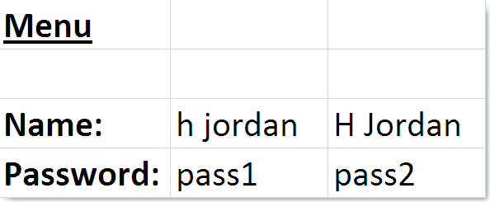
Spreadsheet so far

Slide 17
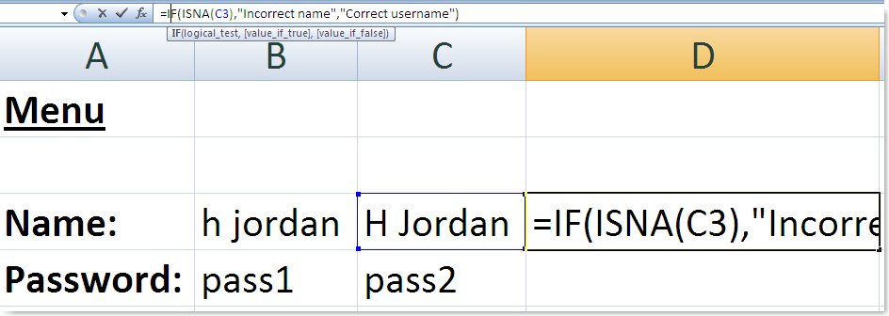
Create a message if the name is in the list
Create an IF statement in cell D3:
The test will be, “does cell C3 have the #N/A error message”?
If it does, this means the name is not is in the list.
If not, that means a valid name is in the list.
=IF(isna(C3), “Incorrect name”, “Correct username”)

Slide 18
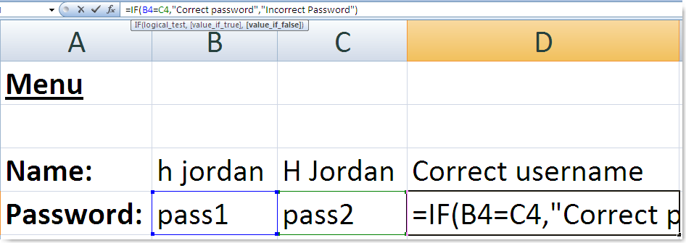
Create a formula that tests whether the password entered in this sheet
Create an IF statement in cell D4:
The test will be,
“Is the text in B3 (the text the user typed on this sheet) the same
as the text in C3 (The password we have on record on the other sheet)
If it does, this means the password is correct.
If not, that means the password is not correct.
=IF(B4=C4, “Correct Password”, “Incorrect Password”)

Slide 19
Test the formulas
The correct password is “pass2”
When we change the password to this, it is accepted

Slide 20
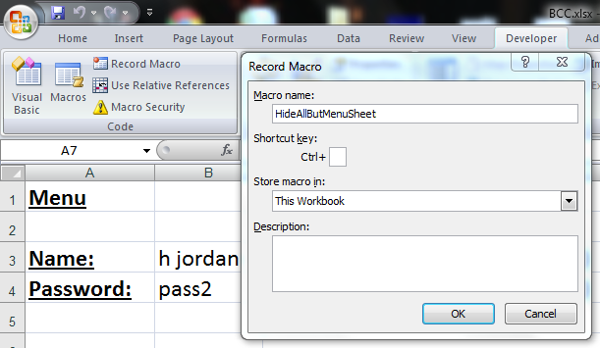
Recording The Macros
Click on the Developer tab, click on Record Macro and call the new macro HideAllButMenuSheet. Click OK and the macro will start recording your actions. Right click on every sheet tab except Menu and press Hide. Click the Stop button located under the sheet tabs to stop recording.

Slide 21
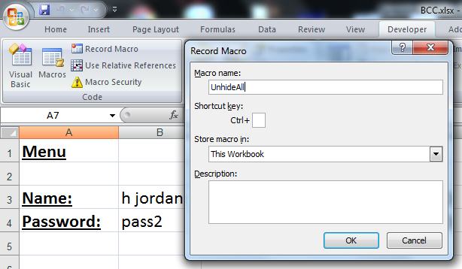
Recording The Macros
Setup a new Macro called UnhideAll. Click OK and the macro will start recording your actions. Right click on the Menu sheet and select Unhide... for each of your sheets. Click the Stop button located under the sheet tabs to stop recording.

Slide 22
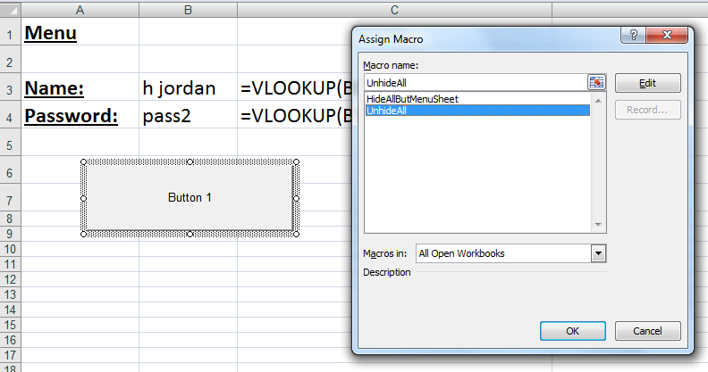
Adding Buttons
Click on the Developer tab and then click on the Insert button. Click on the Button button under Form Controls and draw a button on your sheet. Assign the UnhideAll macro to this button.

Slide 23
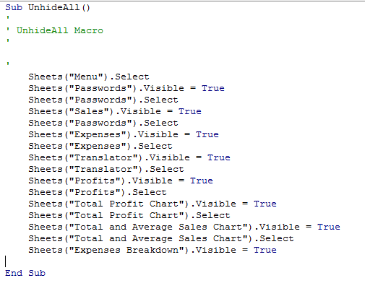
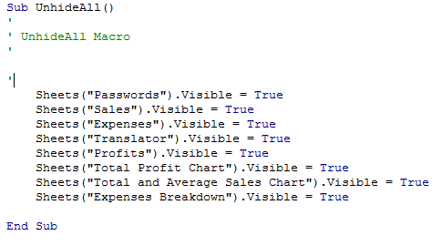
Editing Your Button
Right-click on your button and choose Assign Macro. Click on Edit on the dialog box.
Edit the code so that it looks like the one above. This will remove any unnecessary code, keeping the lines relating to unhiding sheets.

Slide 24
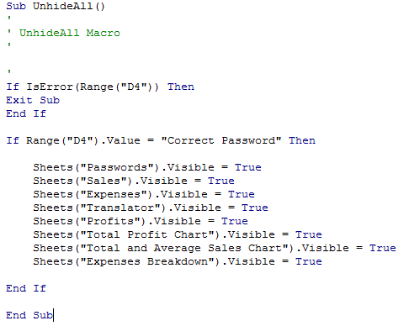
Editing Your Button
Enter the additional Visual Basic code that has been highlighted.
It will check to see if the correct password has been entered. If is hasn’t, then the macro will stop running. If it is correct then the sheets will be unhidden.

Slide 25
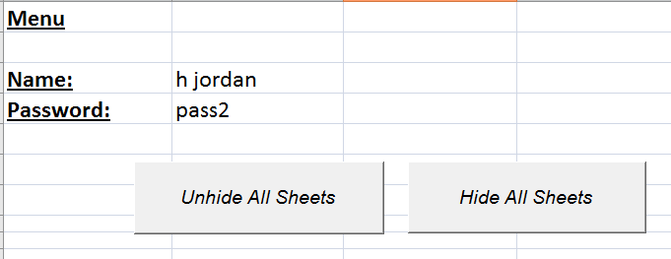
Editing Your Button
Rename your button Unhide All Sheets. Draw out another button, assign the HideAllButMenuSheet macro and name the button Hide All Sheets.

Slide 26
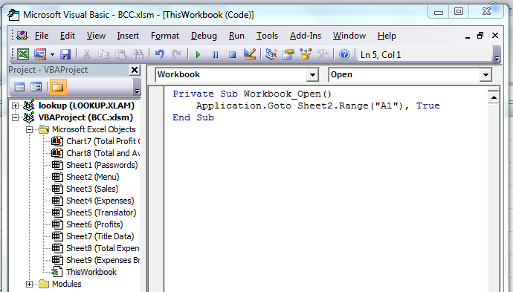
Event Control
When we open the spreadsheet, we want to go to the menu sheet to enter the passwords.
Click on the Visual Basic button under the Developer tab.
Click on ThisWorkbook and then enter the following code:
Sheet2 is the sheet where the user name and password entry can be found.

Slide 27
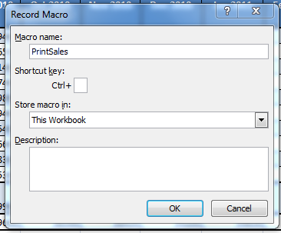
Customised Printing
You will need to create printouts of specific parts of your spreadsheet. Go to sheet with your sales data. Click on the Record Macro button located under your sheet tabs.
Call the macro PrintSales and press Ok
Begin by selecting the area that shows your sales data including the expected sales for April 2011.

Slide 28
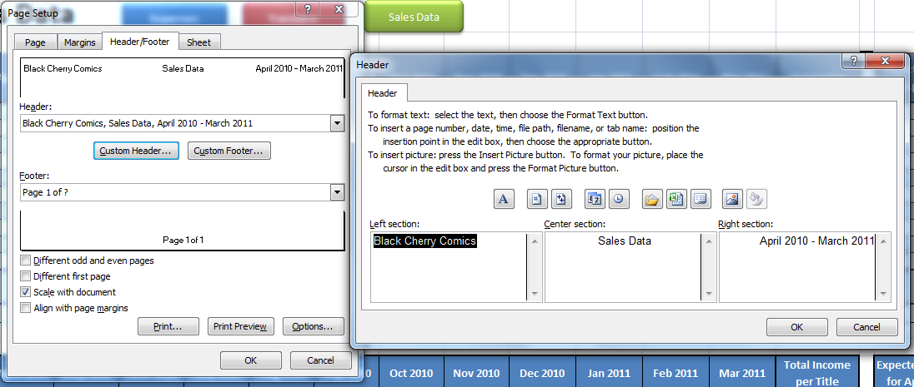
Customised Printing
Under the Page Layout tab, click on Print Area and select Set Print Area.
Click on Print Titles and set up your Header/Footer as shown:

Slide 29
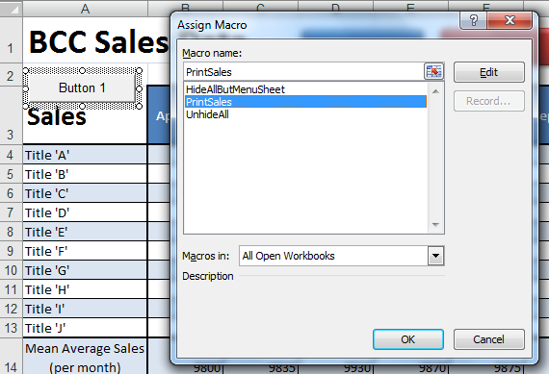
Customised Printing
Draw out a button and assign the PrintSales macro to it. Give the button a proper name.

Slide 30
Customised Printing
Repeat this process for the following tables:
Income
Expenses (for each title)
Translator fees
Profit

Slide 31
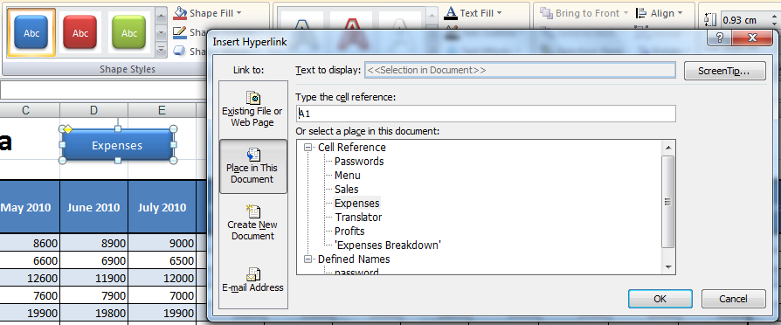
Adding Navigation
Draw out a shape, right click on it and select Add Text. Enter the name of one of your sheets.
Right-click on your shape again and choose Hyperlink...
Click on Place in This Document and select the sheet you want to link to. Press Ok.
Create a set of navigation buttons on each sheet.

Slide 32
Creating a Pivot Table
Organise your Translator table so that it looks like the one below:

Slide 33
Creating a Pivot Table
Under the Insert tab, click on the Pivot Table button.
Click on the selection button under Select table or range option.
Highlight the area with your table except the Total column.
Press OK.

Slide 34
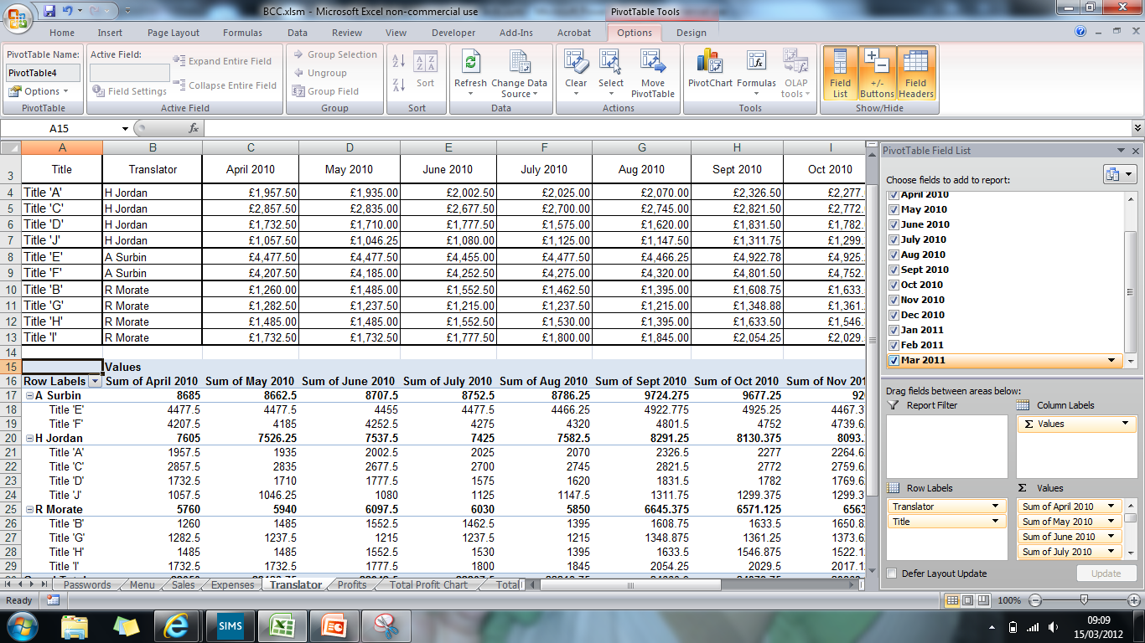
Creating a Pivot Table
Tick all the options for the fields to add to your report.
You can drag the fields about to change the views of your pivot table.

Slide 35
Creating Alternative Formats
Click on the Office Button and go to Save As...
Choose Web Page from Save as type:
Add a Page Title and press Save.

Slide 36
Unlocking Cells
Select cells that need to be unlocked – this will allow you to enter data. Right-click on them and select Format Cells. Under the Protection tab, untick Locked and press OK.
Keep cells with formulas in locked as you do not want them to be changed.

Slide 37
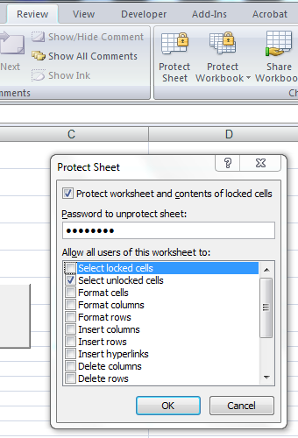
Protecting Sheets
Click on the Review tab and click on the Protect Sheet button.
Untick Select Locked Cells, add a password and press OK.
All cells will be locked except those that have been unlocked.

Slide 38
Protecting Sheets
Click on the Review tab and click on the Protect Sheet button.
Untick Select Locked Cells, add a password and press OK.
All cells will be locked except those that have been unlocked.

